Slide 1
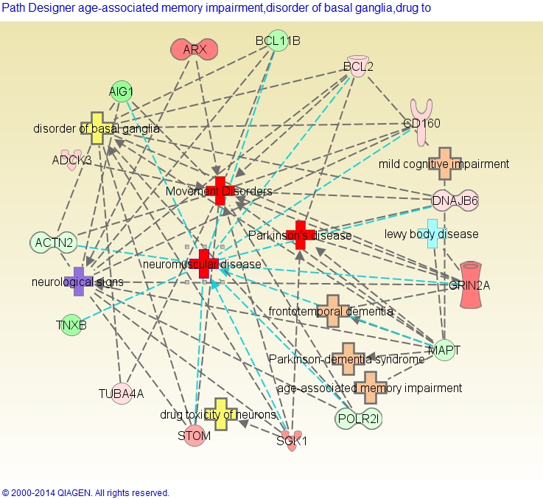
Figure S1. IPA® gene and function interconnection network of Blood DML related genes associated with PD and other similar disorders as derived from the comparison of PD cases with Plantation Work 10+ vs 0 years.
Footnote: The DML genes are shown in capitals and either red (for hypermethylation) or green (for hypomethylation) icons. The shade of the filled color reflects the level of methylation (darker differing more from the average).

Slide 2
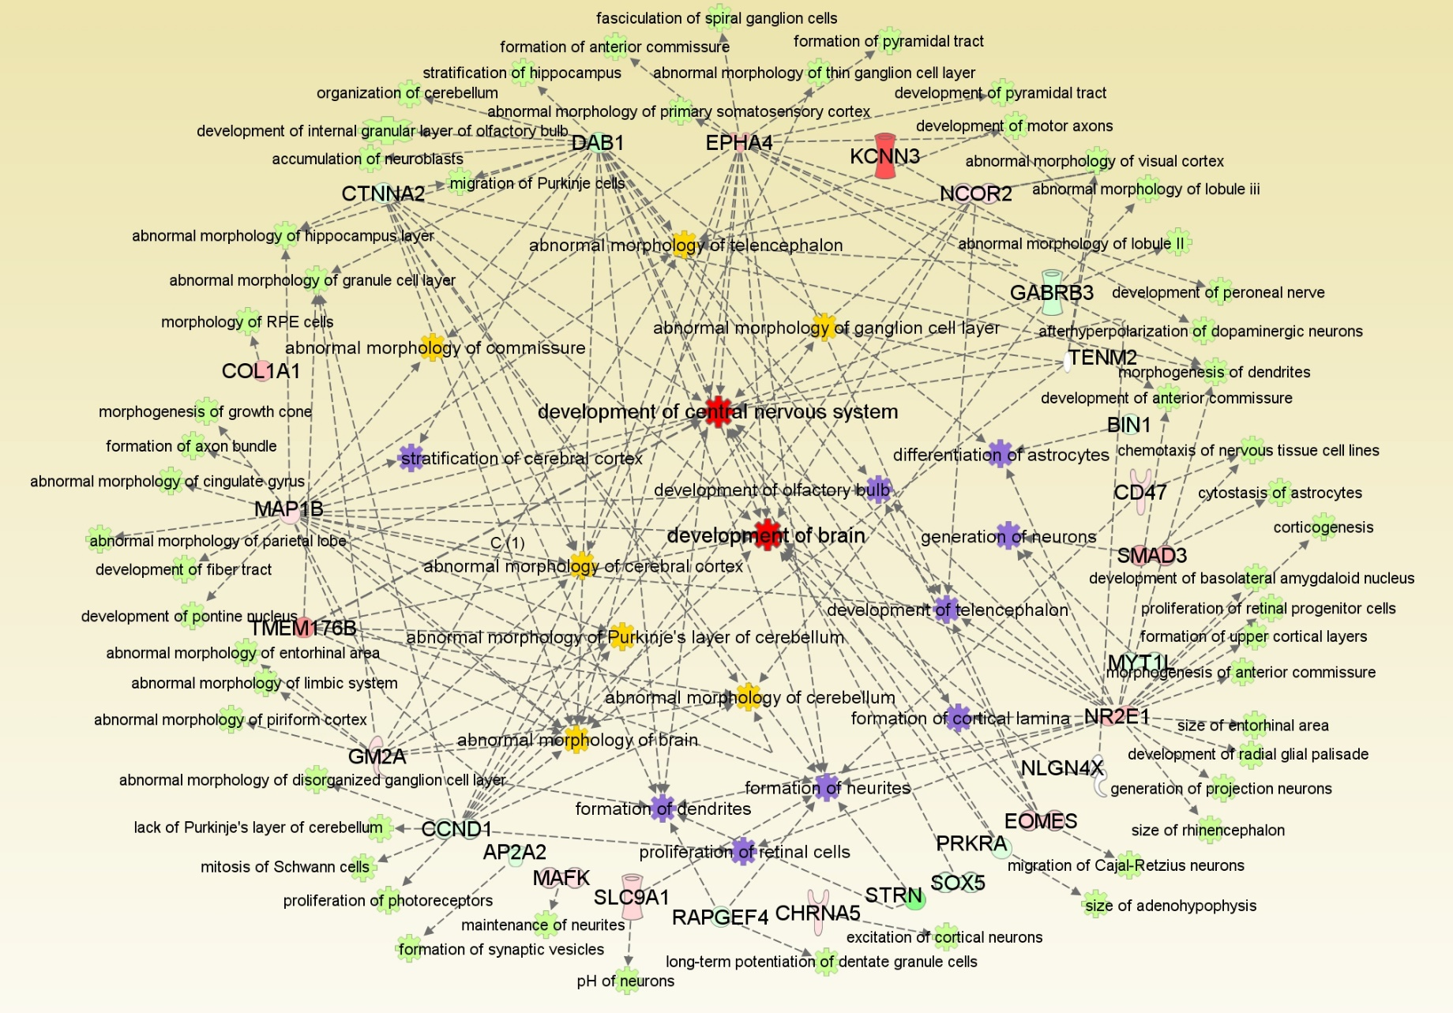
Figure S2. IPA® gene and function interconnection network of Blood DML related genes associated with neurological development and abnormal brain morphology as derived from the comparison of PD cases with 4+ OGCs and vs 0-2 OGCs.
Footnote: The DML genes are shown in capitals and either red (for hypermethylation) or green (for hypomethylation) icons. The shade of the filled color reflects the level of methylation (darker differing more from the average).

